Slide 1
Hearthstone Database
Eric Chao, Michael Wibawa

Slide 2
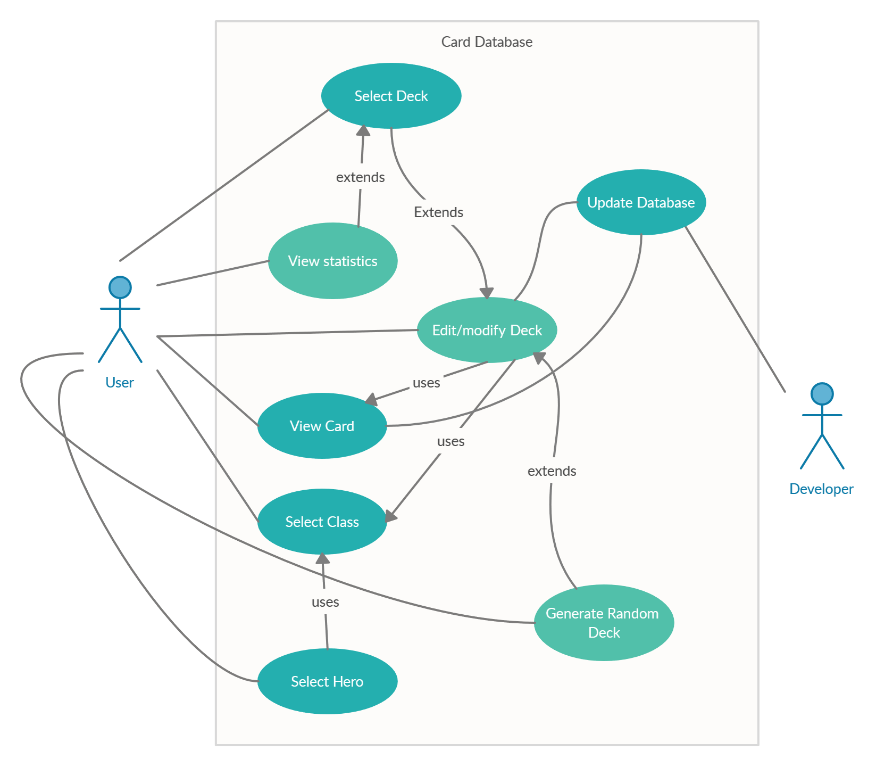
UML Diagram

Slide 3
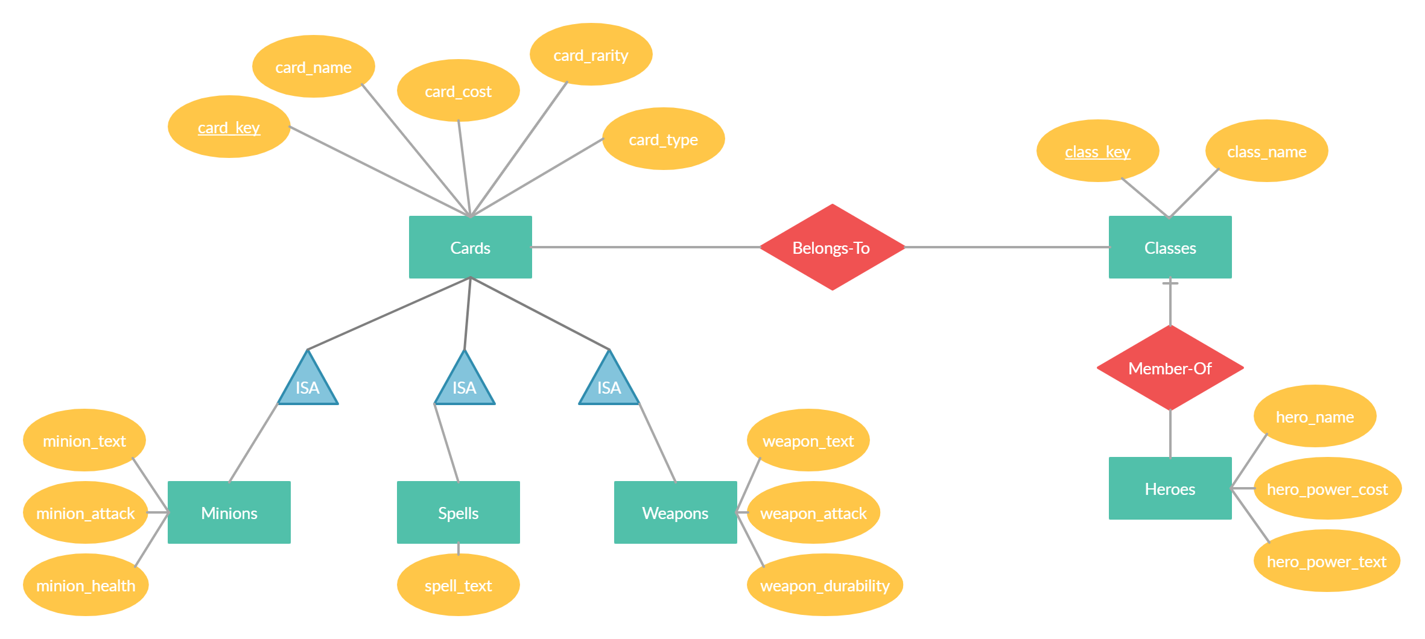
E/R Diagram

Slide 4
Tables
Cards (key, name, cost, rarity, type)
Minions (cardKey, attack, health, text)
Spells (cardKey, text)
Weapons (cardKey, attack, durability, text)
Classes (key, name)
ClassCards (cardKey, classKey)
Heroes (classKey, name, powerCost, powerText)

